Slide 1
Module 3: IP SAN and FCoE, NAS
Dr. S. Nandagopalan

Slide 2
Syllabus
Module 3 (8 hours)
Chapter 6:
IP SAN and FCoE: iSCSI, FCIP
Chapter 7 : NAS:
General-Purpose Servers versus NAS Devices
Benefits of NAS
File Systems and Network File Sharing
Components of NAS
NAS I/O Operation
NAS Implementations
NAS File-Sharing Protocols
Factors Affecting NAS Performance

Slide 3
Chapter 6:
iSCSI

Slide 4
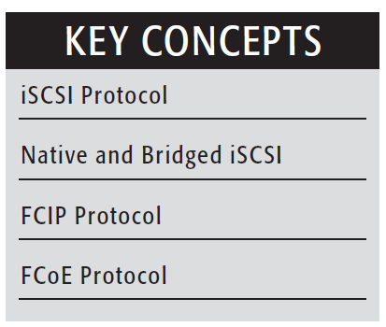
Introduction
iSCSI and Fibre Channel (FC):
Two Main Approaches to Storage Data Transmission
In general, FC is a high-performance but expensive storage network that requires specialized admin skill sets.
iSCSI is less expensive and simpler to deploy and manage, but has higher latency.

Slide 5
Introduction (contd.)
IP SAN – transporting block I/Os over an existing IP Network
FC SAN – Fibre Channel SAN
Using IP as a storage networking option provides several advantages
Use existing hardware – no special network needed
Can extend the geographical reach of their storage infrastructure
Three primary protocols:
InternetSCSI (iSCSI) and
Fibre Channel over IP (FCIP)
Fibre Channel over Ethernet (FCoE).

Slide 6
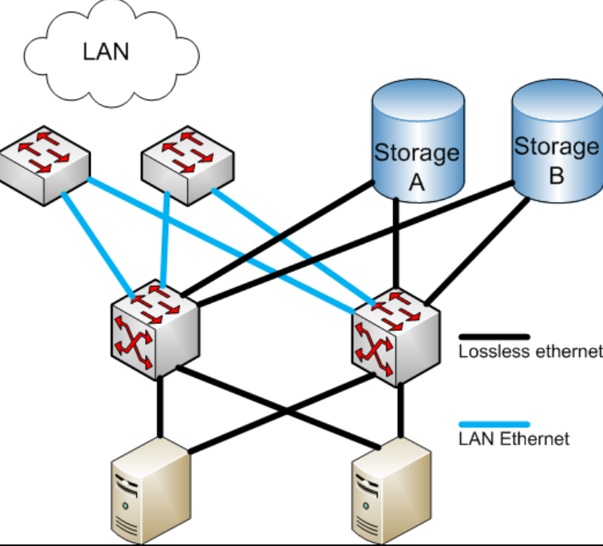
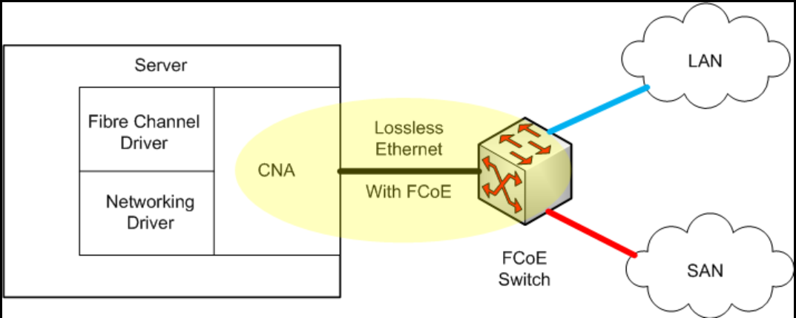
Example Network

Slide 7
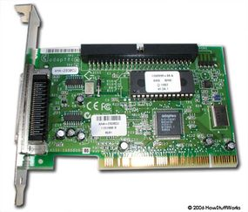
What is SCSI ?
SCSI – Simple Computer System Interface
Connecting Mobile phone, printer to a Host – USB port
Can connect lots of devices to a computer at the same time, including hard drives, scanners, CD-ROM/RW drives, printers and tape drives (320 MBps).
SCSI controller

Slide 8
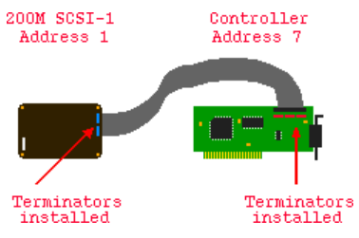
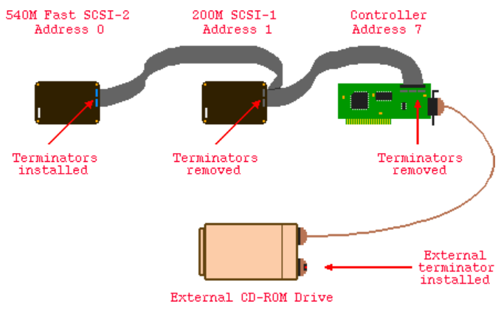
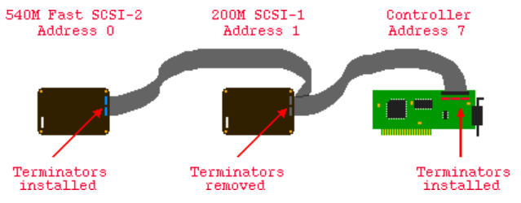
Examples
Example 1: 2091 controller,
internal 200M SCSI-1 hard drive.
Example 3: An external SCSI-2 CD-ROM drive
has been added
Example 2: An internal 540M
Fast SCSI-2 hard drive has been added

Slide 9
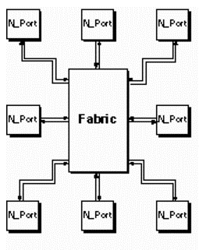
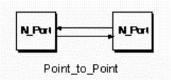
Fibre Channel Overview
Fibre channel is a high performance serial link supporting its own, as well as higher level protocols such as the FDDI, SCSI, HIPPI and IPI
The intention of the Fibre Channel (FC) is to develop practical, inexpensive, yet expendable means of quickly transferring data between workstations, mainframes, supercomputers, desktop computers, storage devices, displays and other peripherals
Fabric - an active intelligent interconnection scheme to connect devices
Fabric

Slide 10
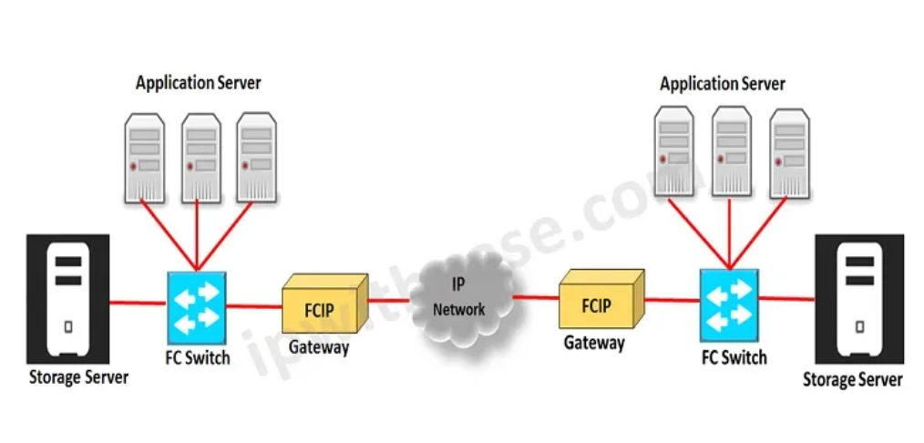
What is FCIP ?
FCIP - Fibre Channel over IP (bridging FC SAN over an IP Network)
Fibre Channel over IP, or FCIP, is a tunneling protocol used to connect Fibre Channel (FC) switches over an IP network, enabling interconnection of remote locations

Slide 11
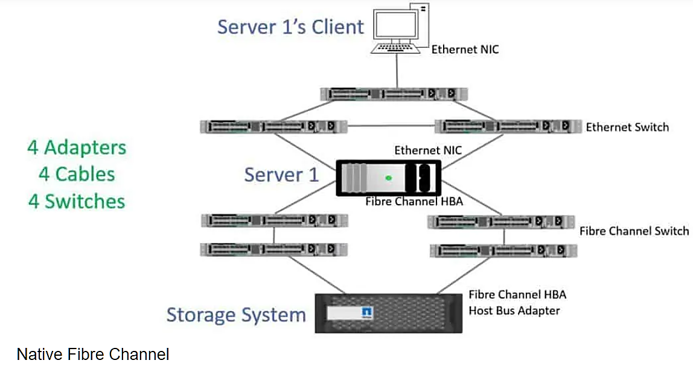
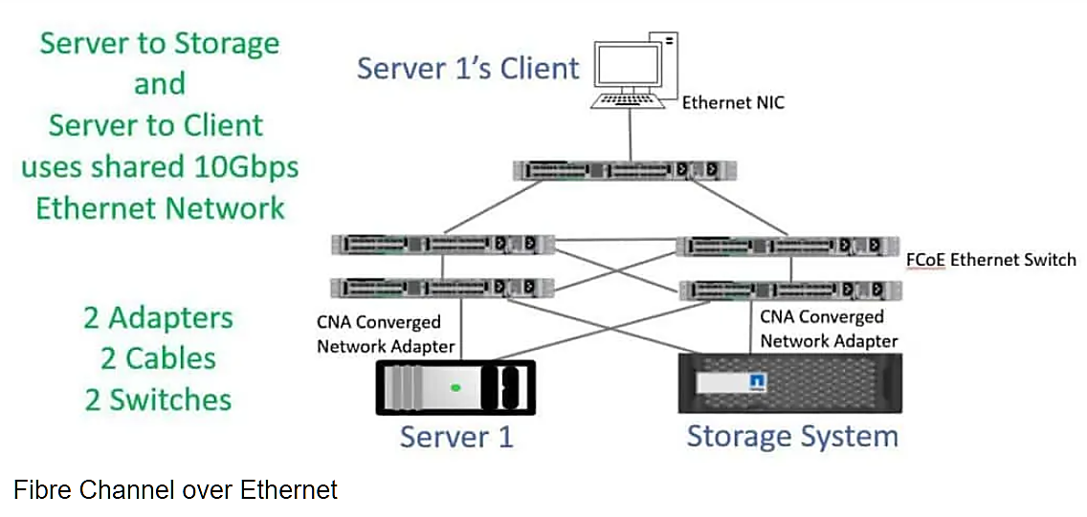
What is FCoE ?
Reduced number of Network Interface Cards (NIC), adapters, cables, and network devices.
Unified Input/Output (I/O) ports.
Simplified Network Management.
Reduced Power and Cooling costs.
Increased System Flexibility.
FCoE - Fibre Channel over Ethernet
FCoE shares Fiber Channel and Ethernet traffic on the same physical cable and also enables enterprises to separate Fibre Channel and Ethernet traffic on the same hardware.

Slide 12
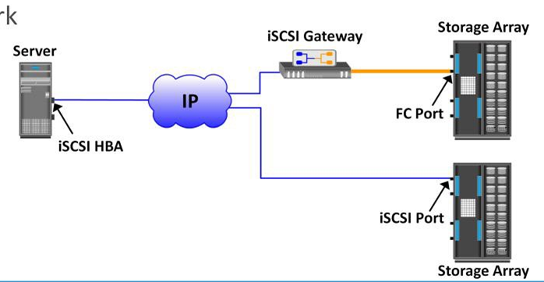
iSCSI
iSCSI is an IP based protocol that establishes and manages connections between host and storage over IP
iSCSI encapsulates SCSI commands and data into an IP packet and transports them using TCP/IP.
iSCSI is widely adopted for connecting servers to storage because it is relatively inexpensive and easy to implement.

Slide 13
Components of iSCSI
An initiator (host) - to route the SCSI commands over an IP network (software/hardware-HBA)
Target (storage or iSCSI gateway) - The iSCSI target is the remote storage, which appears to the host system as a local drive
An IP-based network

Slide 14
iSCSI Host Connectivity
iSCSI host connectivity options:
A standard NIC with software iSCSI initiator - easiest
A TCP offload engine (TOE)
NIC with software iSCSI initiator, and an iSCSI HBA (host based adaptor)
A standard NIC with a software iSCSI initiator is the simplest and least expensive connectivity option (most servers come with one or two NICs)
NICs provide standard IP function, encapsulation of SCSI into IP packets and decapsulation are carried out by the host CPU.
CONS: Increases overhead on host CPU!

Slide 15
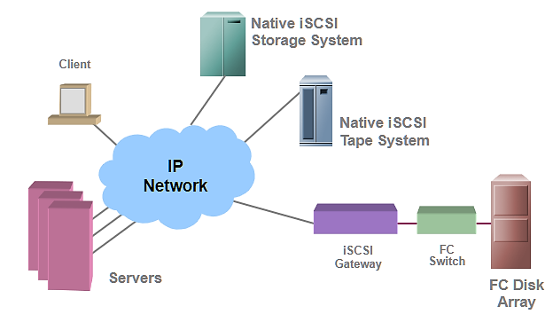
iSCSI Topologies
Native topology - does not have FC components. The initiators may be either directly attached to targets or connected through the IP network.
Bridged topology - enables the coexistence of FC with IP by providing iSCSI-to-FC bridging functionality
Native & Bridged (see figure)

Slide 16
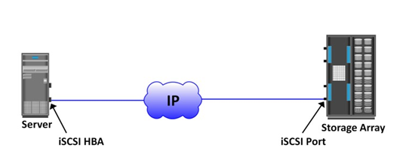
Native iSCSI Connectivity
No FC components
The array has one or more iSCSI ports configured with an IP address and is connected to a standard Ethernet switch
After an initiator is logged on to the network, it can access the available LUNs on the storage array
A single array port can service multiple hosts or initiators

Slide 17
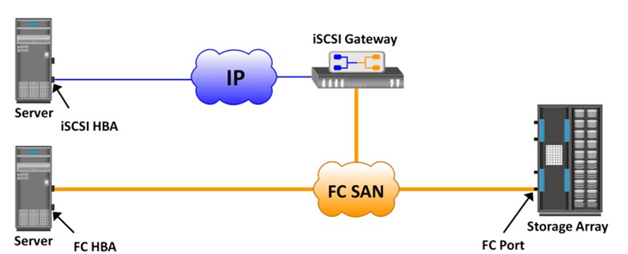
Bridged iSCSI Connectivity
Includes FC components
The array does not have any iSCSI ports
Gateway or a multiprotocol router, must be used to facilitate the communication between the iSCSI host and FC storage
The gateway converts IP packets to FC frames and vice versa
The iSCSI initiator is configured with the gateway’s IP address as its target destination. On the other side, the gateway is configured as an FC initiator to the storage array

Slide 18
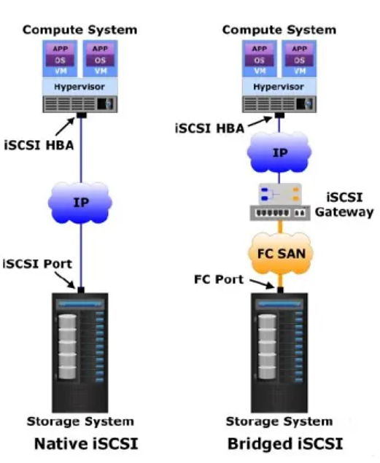
Native vs. Bridged

Slide 19
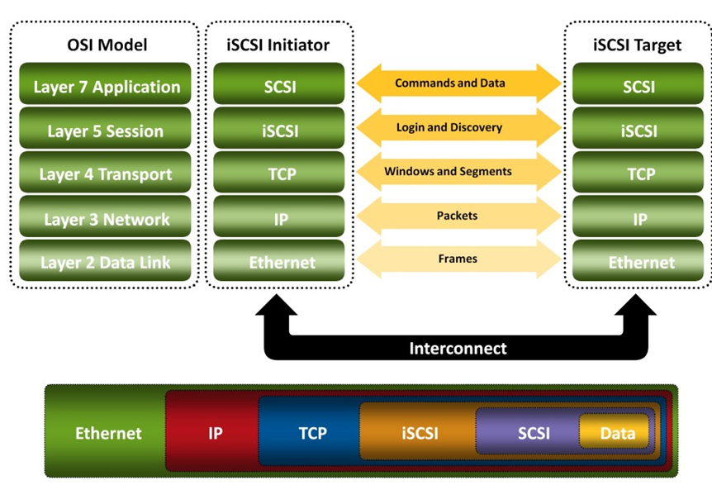
iSCSI Protocol Stack
Initiators and targets use SCSI commands and responses to talk to each other
The SCSI command descriptor blocks, data, and status messages are encapsulated into TCP/IP and transmitted across the network between the initiators and targets.
iSCSI is the session-layer protocol that initiates a reliable session between devices that recognize SCSI commands and TCP/IP.
The iSCSI session-layer interface is responsible for handling login, authentication, target discovery, and session management.
TCP is used with iSCSI at the transport layer to provide reliable transmission.

Slide 20
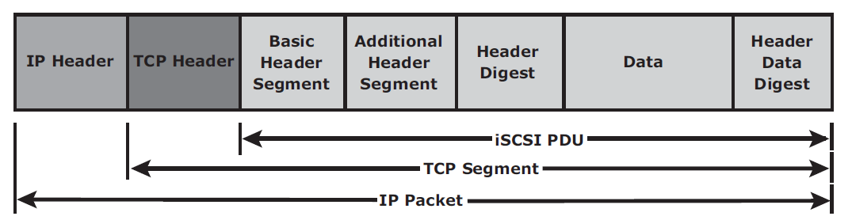
iSCSI Protocol Data Unit (PDU)
The iSCSI initiators and targets communicate with each other using iSCSI PDUs.
It includes
establishing iSCSI connections and iSCSI sessions
performing iSCSI discovery
sending SCSI commands and data
receiving SCSI status.
All iSCSI PDUs contain one or more header segments followed by zero or more data segments.
The PDU is then encapsulated into an IP packet to facilitate the transport.

Slide 21
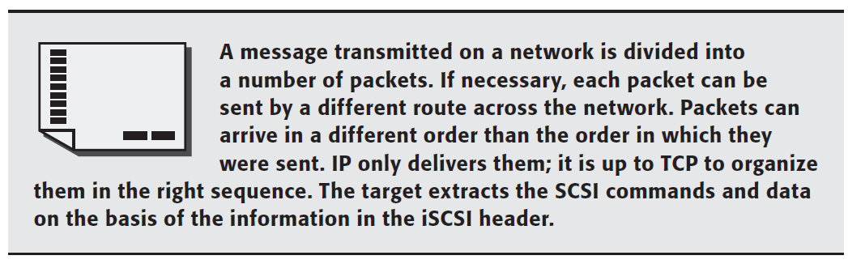
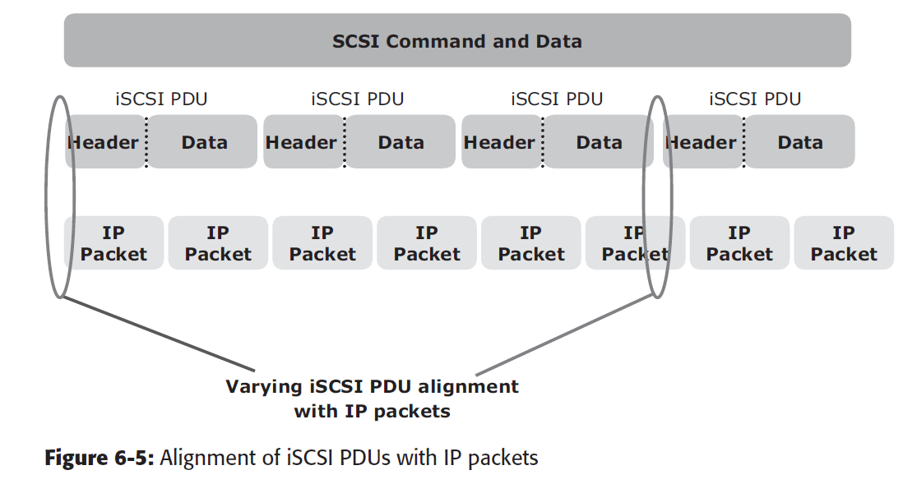
Message Transmission

Slide 22
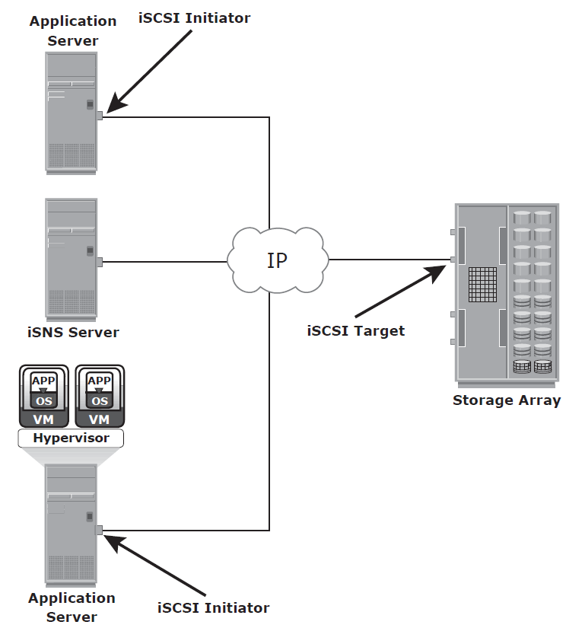
iSCSI Discovery
An initiator must discover the location of its targets on the network for session establishment
This discovery can take place in two ways:
SendTargets discovery - the initiator is manually configured with the target’s network portal to establish a discovery session. The initiator issues the SendTargets command, and the target network portal responds with the names and addresses of the targets available to the host.
internet Storage Name Service (iSNS) - automatic discovery of iSCSI devices on an IP network

Slide 23
iSCSI Names
A unique worldwide iSCSI identifier is used to identify the initiators and targets within an iSCSI network to facilitate communication.
types of iSCSI names
iSCSI Qualified Name (IQN): An organization must own a registered domain name to generate iSCSI Qualified Names
E.g. iqn.2008-02.com.example:optional_string
Extended Unique Identifier (EUI): globally unique identifier based on the IEEE EUI-64 naming standard
E.g. eui.0300732A32598D26

Slide 24
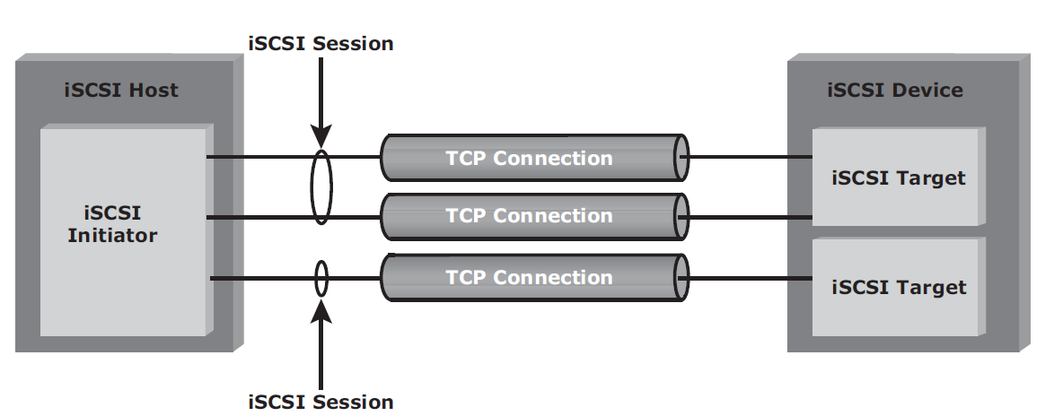
iSCSI Session
Established between an initiator and a target via login process
The discovery of the available targets by the initiators and the location of a specific target on a network
The normal operation of iSCSI (transferring data between initiators and targets) and finally terminate the session

Slide 25
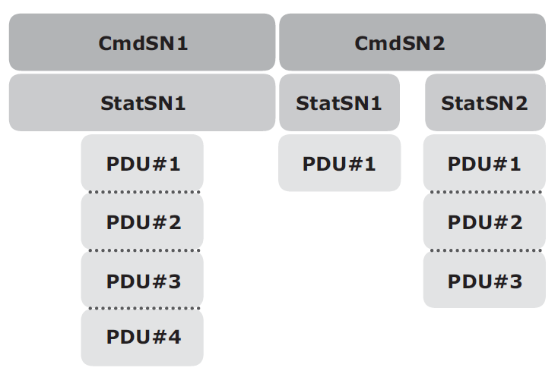
iSCSI Command Sequencing
The iSCSI communication between the initiators and targets is based on the request-response command sequences with multiple PDUs.
A command sequence number (CmdSN) within an iSCSI session is used for numbering all initiator-to-target command PDUs belonging to the session.
This number ensures that every command is delivered in the same order in which it is transmitted, regardless of the TCP connection that carries the command in the session.
status sequence number (StatSN) – to sequentially number status responses and established at the level of the TCP connection.

Slide 26
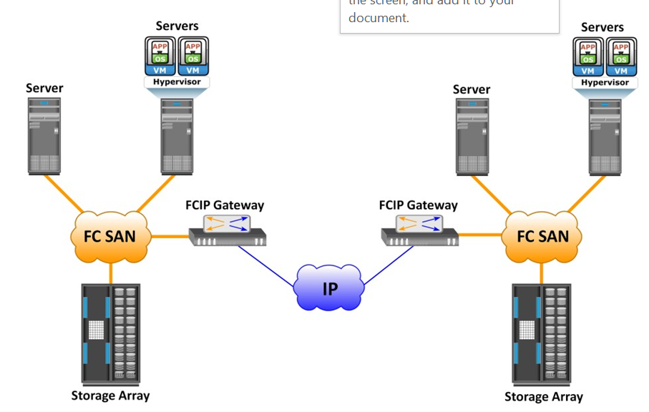
FCIP
Fibre Channel over IP, or FCIP is a tunneling protocol that enables distributed FC SAN islands (distributed over geographical locations) to be interconnected over the existing IP-based networks.

Slide 27
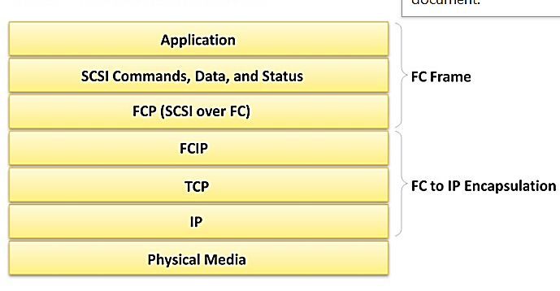
FCIP Protocol Stack
The upper layer protocol SCSI includes the SCSI driver program that executes the read-and-write commands.
Below the SCSI layer is the Fibre Channel Protocol (FCP) layer, which is simply a Fibre Channel frame whose payload is SCSI.
The FCP layer rides on top of the Fibre Channel transport layer.
This enables the FC frames to run natively within a SAN fabric environment.

Slide 28
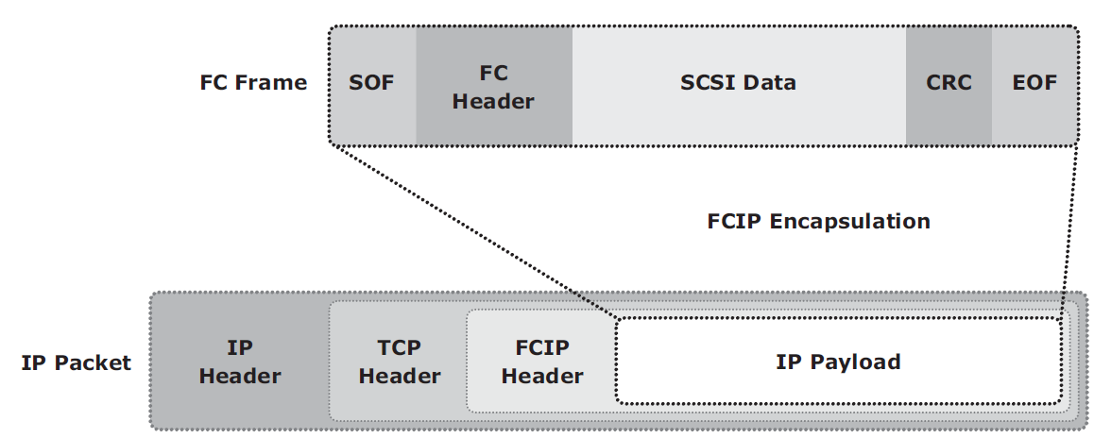
FCIP encapsulation
The FCIP layer encapsulates the Fibre Channel frames onto the IP payload and passes them to the TCP layer.
TCP and IP are used for transporting the encapsulated information across Ethernet, wireless, or other media that support the TCP/IP traffic.
IP packet fragmentation must be handled.

Slide 29
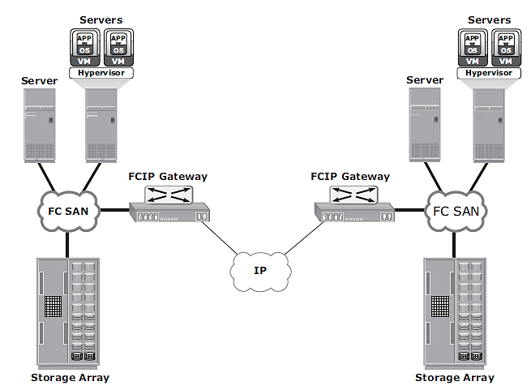
FCIP Topology
An FCIP gateway is connected to each fabric via a standard FC connection.
The FCIP gateway at one end of the IP network encapsulates the FC frames into IP packets. The gateway at the other end removes the IP wrapper and sends the FC data to the layer 2 fabric.
fabric - describes the network topology in which components pass data to each other through interconnecting switches.

Slide 30
FCIP Performance and Security
Performance - configuring multiple paths between FCIP gateways eliminates single points of failure and provides increased bandwidth.
FCIP creates a unified fabric - disruption in the underlying IP network can cause instabilities in the SAN environment - segmented fabric, excessive RSCNs, and host timeouts.
Solution – virtual fabric
Security - the data is transmitted over public IP channels (IPSec)

Slide 31
Chapter 7:
NAS – Network Attached Storage

Slide 32
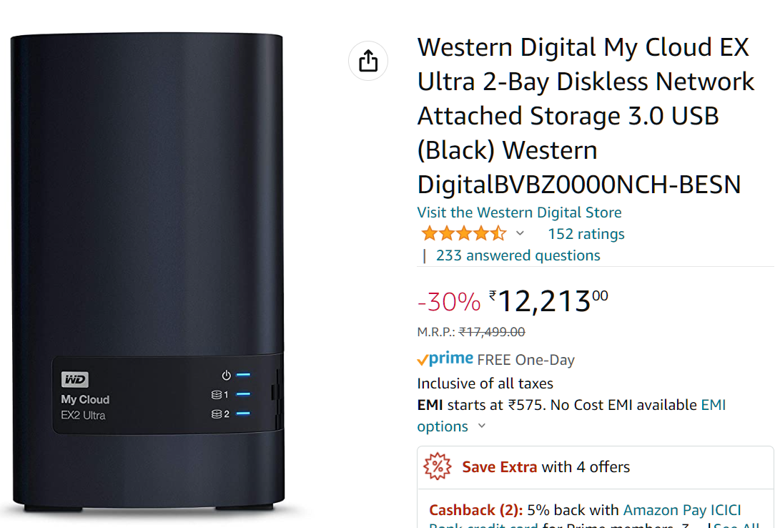
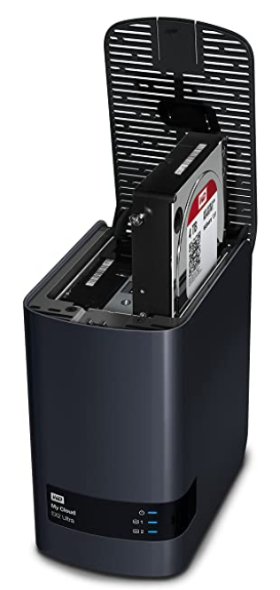
Introduction
https://youtu.be/3yZDDr0JKVc
https://youtu.be/Egqh5Lz7rAo
NAS is a dedicated, high-performance file sharing and storage device.
NAS enables its clients to share files over an IP network.

Slide 33
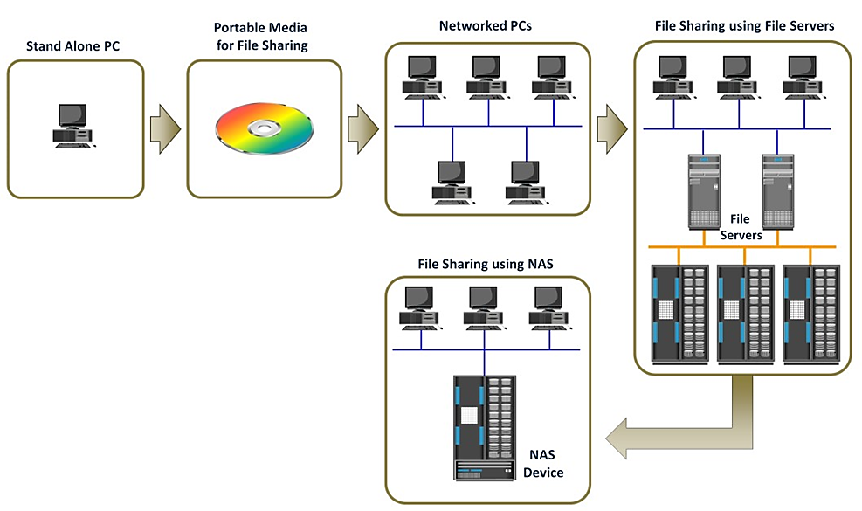
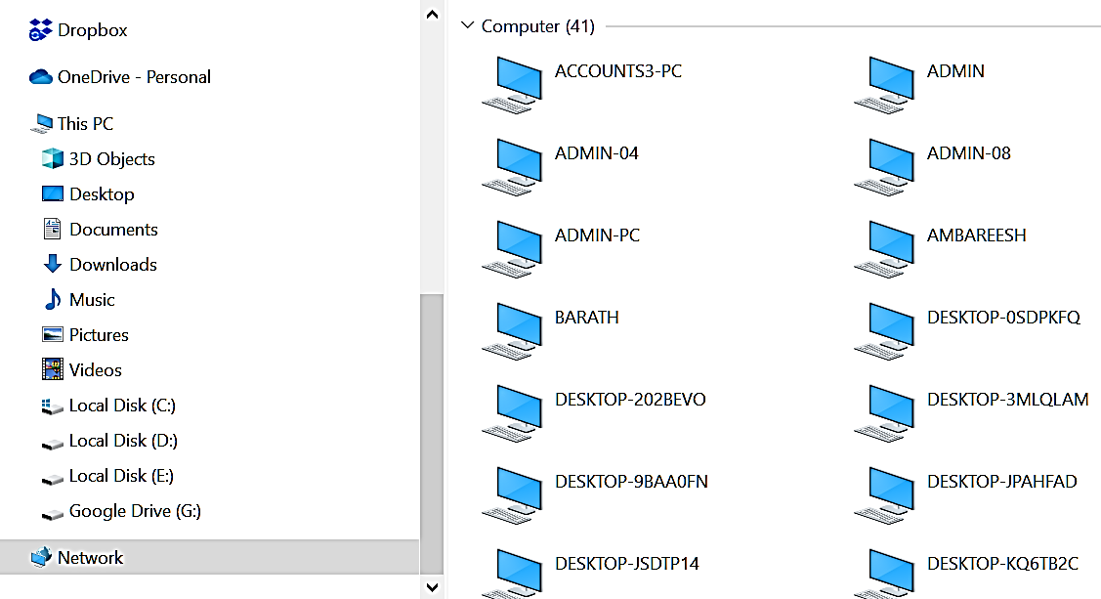
File Sharing Technology Evolution

Slide 34
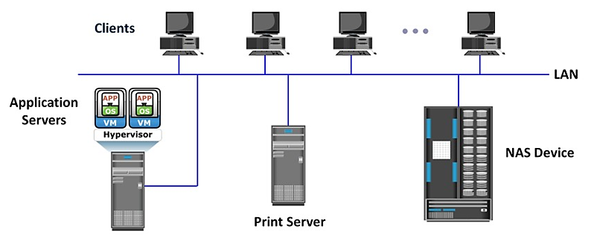
What is NAS?

Slide 35
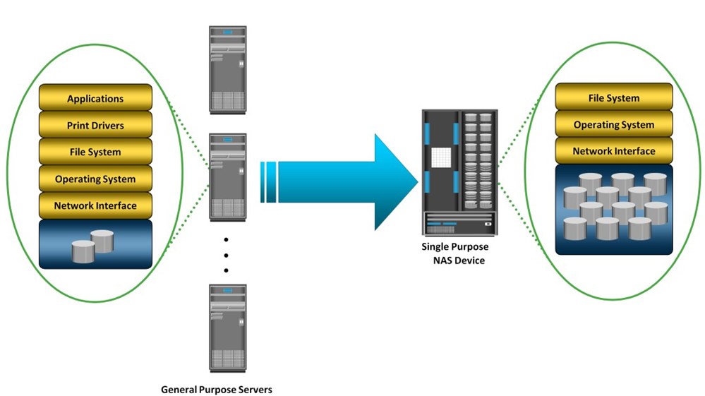
General-Purpose Servers versus NAS Devices
A general-purpose server - used to host any application because it runs a general-purpose operating system.
NAS device - is dedicated to file-serving with its own OS

Slide 36
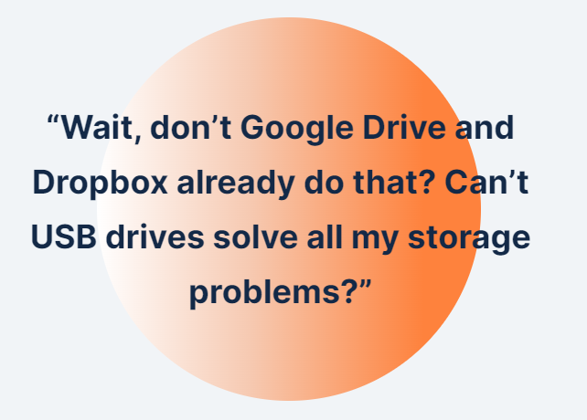
Why NAS?

Slide 37
Benefits of NAS
Comprehensive access to information
Improved efficiency
Improved flexibility
Centralized storage
Simplified management
Scalability
High availability
Security
Low cost
Ease of deployment

Slide 38
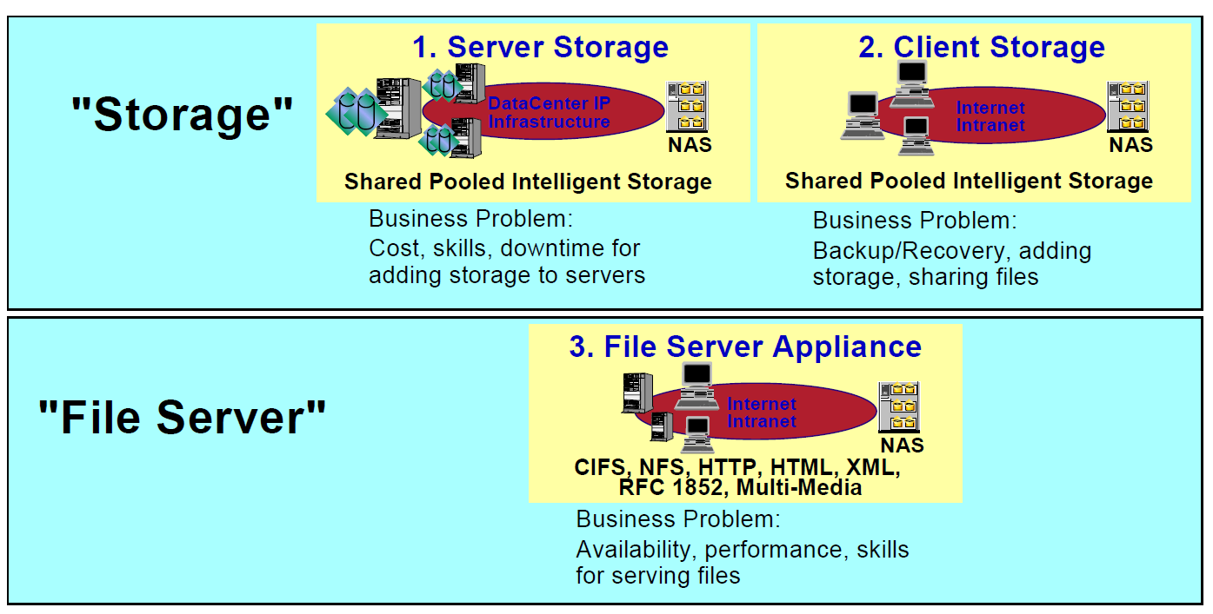
Uses of NAS

Slide 39
File Systems and Network File Sharing
A file system is a structured way to store and organize data files.
(a) Accessing a File System
A file system must be mounted before it can be used.
The operating system mounts a local file system during the boot process.
The mount process creates a link between the file system on the NAS and the operating system on the client.
The operating system organizes files and directories in a tree-like structure
(b) Network File Sharing
Network file sharing refers to storing and accessing files over a network
E.g. FTP, DFS, P2P, etc.
DNS - helps users identify and access a unique resource over the network

Slide 40
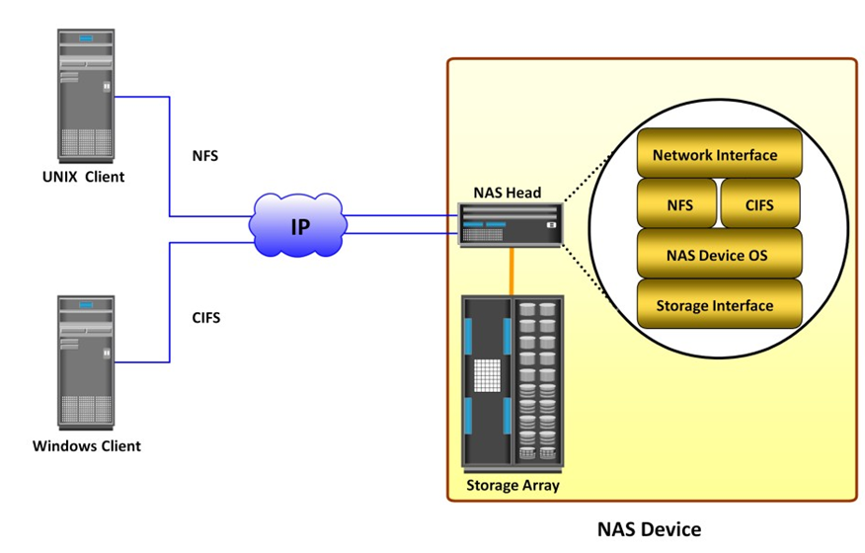
Components of NAS
NAS head and storage
NAS Head
CPU and memory
NICs - to the client network. E.g. Gigabit Ethernet, Fast Ethernet, ATM, and Fiber Distributed Data Interface (FDDI).
An optimized operating system for managing the NAS functionality.
NFS, CIFS, and other protocols for file sharing
Industry-standard storage protocols and ports to connect and manage physical disk resources

Slide 41
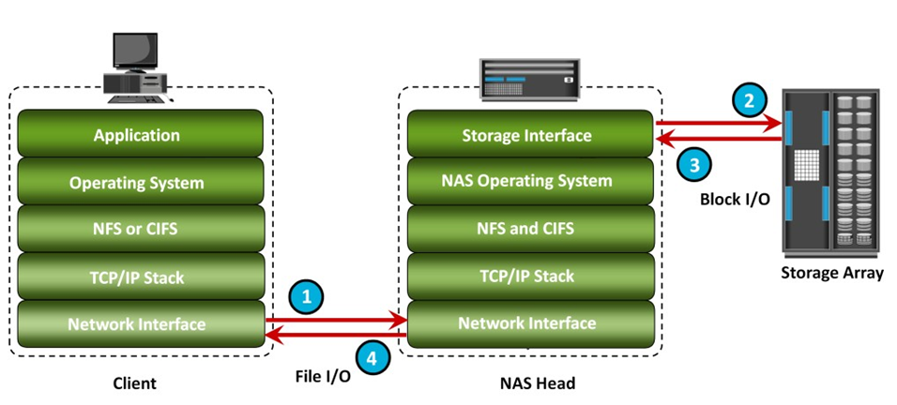
NAS I/O Operation
The requestor (client) packages an I/O request into TCP/IP and forwards it through the network stack. The NAS device receives this request from the network.
The NAS device converts the I/O request into an appropriate physical storage request, which is a block-level I/O, and then performs the operation on the physical storage.
When the NAS device receives data from the storage, it processes and repackages the data into an appropriate file protocol response.
The NAS device packages this response into TCP/IP again and forwards it to the client through the network.

Slide 42
NAS Implementations
unified - NAS-based and SAN-based data access within a unified storage platform and provides a unified management interface for managing both the environments
gateway - NAS device uses external storage to store and retrieve data
scale-out - pools multiple nodes together in a cluster

Slide 43
(a) Unified NAS
A unified NAS contains one or more NAS heads and storage in a single system
Performs file serving and storing of file data, along with providing access to block-level data.
It supports both CIFS and NFS protocols for file access and iSCSI and FC protocols for block level access

Slide 44
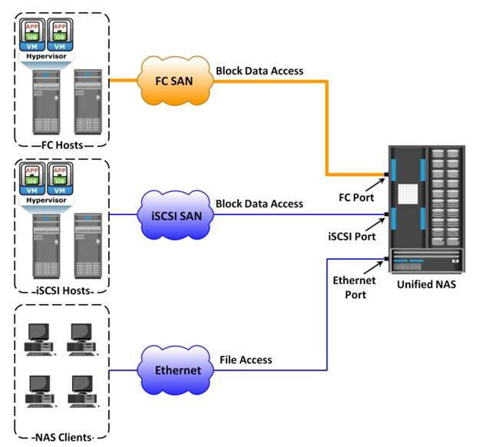
Unified NAS - Example
Each NAS head NAS has front-end Ethernet ports, which connect to the IP network.
The front-end ports provide connectivity to the clients and service the file I/O requests.
Each NAS head has back-end ports, to provide connectivity to the storage controllers.

Slide 45
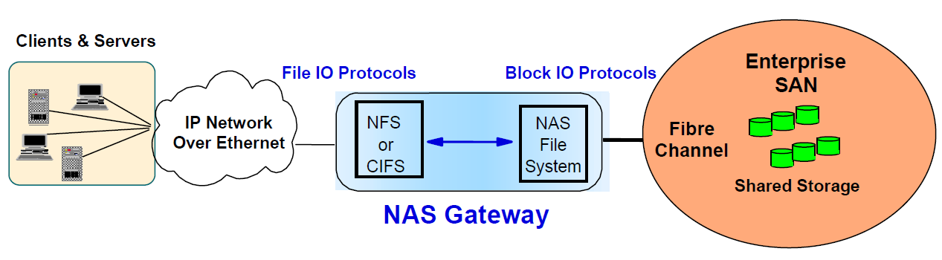
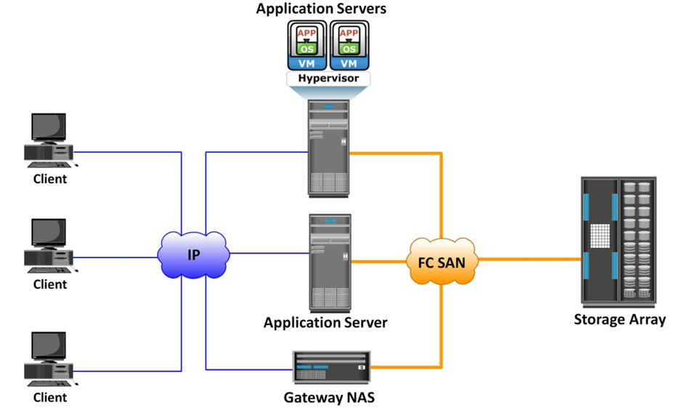
(b) Gateway NAS Connectivity
In a gateway solution, the front-end connectivity is similar to that in a unified storage solution. Communication between the NAS gateway and the storage system in a gateway solution is achieved through a traditional FC SAN.

Slide 46
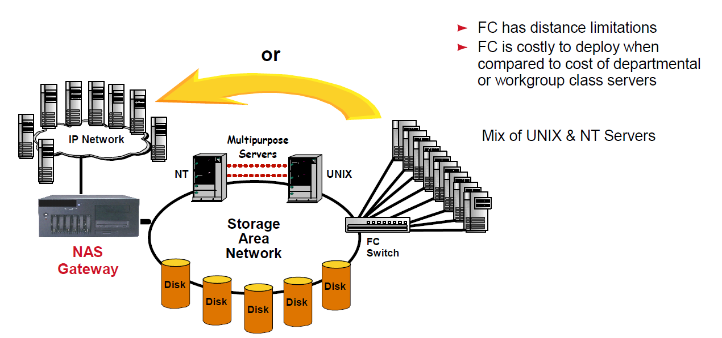
NAS Gateway…

Slide 47
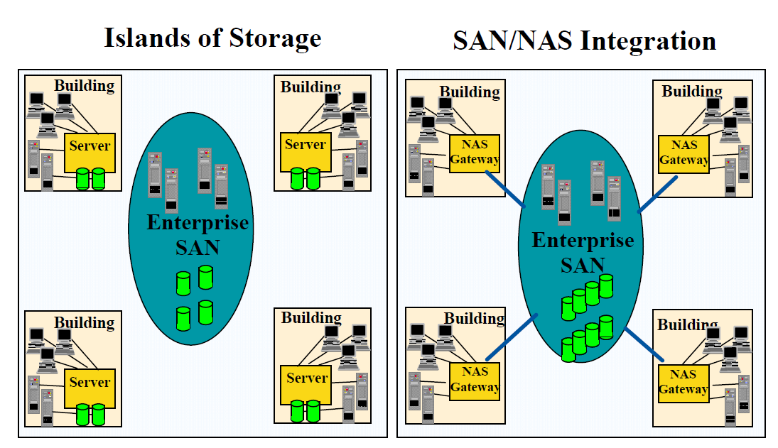
Example - Customer

Slide 48
(c) Scale-Out NAS
Adding CPUs, memory, and storage to the NAS device
Enables grouping multiple nodes together to construct a clustered NAS system
The cluster works as a single NAS device and is managed centrally
creates a single file system that runs on all nodes in the cluster and sharable.
As data is sent from clients to the cluster, the data is divided and allocated to different nodes in parallel.
When a client sends a request to read a file, the scale-out NAS retrieves the appropriate blocks from multiple nodes, recombines the blocks into a file, and presents the file to the client.

Slide 49
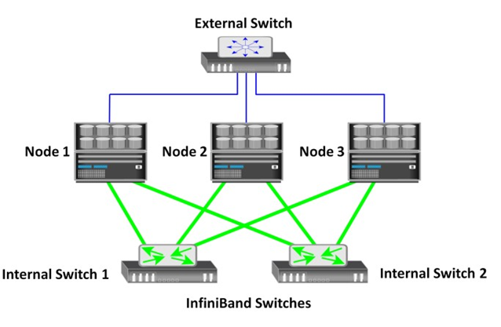
Example
An internal network provides connections for intracluster communication.
An external network connection enables clients to access and share file data.
Each node in the cluster connects to the internal network.

Slide 50
NAS File-Sharing Protocols
NFS – self study
CIFS – self study

Slide 51
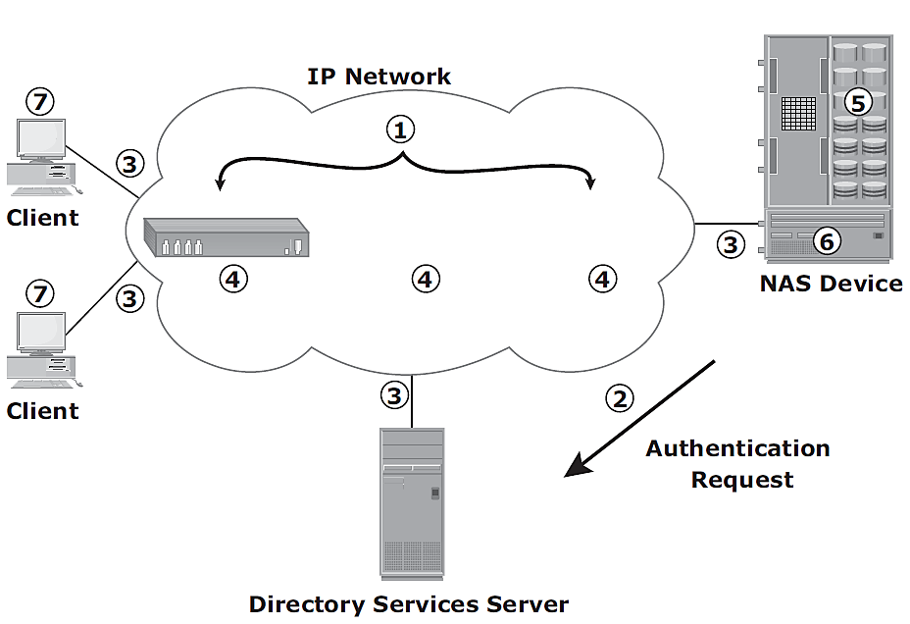
Factors Affecting NAS Performance
Number of hops
Authentication with a directory service such as Active Directory or NIS
Retransmission
Over utilized routers and switches
File system lookup and metadata requests
Over utilized NAS devices
Over utilized clients

Slide 52
How to Set up a NAS Device?
https://www.youtube.com/watch?v=PrVAehzT8Yk

Slide 53
Review Questions
Write a note on iSCSI.
Discuss different iSCSI topologies.
Describe iSCSI protocol stack.
Define FCoE. Explain its components.
Explain FC protocol stack.
What is FCIP and explain its protocol stack.
What is NAS? Discuss components of NAS.
List and discuss benefits of NAS.
What are the different ways to implement NAS? Explain.

